Slide 1
What is JavaScript
Designed to add interactivity to HTML pages
Is a scripting language
Scripts execute without having to be compiled first
JavaScript code is usually embedded directly into HTML pages

Slide 2
What can Javascript do?
JavaScript can put dynamic text into an HTML page
JavaScript can react to events
JavaScript can read and write HTML elements
JavaScript can be used to validate input data
JavaScript can be used to detect the visitor's browser
JavaScript can be used to create cookies

Slide 3
Where to put Javascript code?
Use the <script> tag
Can be placed in the <body> and the <head> sections of an HTML page.
<html>
<head>
<script>
-- Javascript code placed here
</script>
</head>
<body>
<script>
-- Javascript code placed here
</script>
</body>
</html>

Slide 4
Referencing External Javascript File
Scripts can be provided locally or remotely accessible JavaScript file using src attribute.
<html>
<head>
<script src=http://somesite/hello.js />
<script src=“subfolder/hello2.js"/>

Slide 5
4 Advantages of external JavaScript
Access the same script from many different webpages
An external code can be reused by many applications.
Single source to avoid different versions of the script in different files.
The script file is cached once downloaded which means that the script does not need to be downloaded separately as part of every Web page

Slide 6


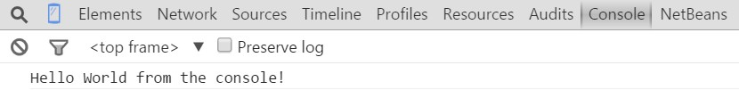
Debugging Javascript
Use console.log() to display JavaScript values in the debugger window.
Chrome browser: Ctrl-Shift-J to show Javascript Console

Slide 7
Javascript Variable
You create a variable with the var statement
All statements end with semicolon.
var length = 16; lastName = "Johnson";
var cars = ["Saab", "Volvo", "BMW"];
// Number
// String
// Array
The lifetime of these variables starts when they are declared, and ends when the page is closed

Slide 8
Operators
Arithmetic operators
 +, -, *, /, %, ++, --
Assignment operators
 =, +=, -=, *=, /=, %=
String operators
var txt1 = “John”; var txt2 = “Doe”;
var txt3 = txt1 + “ “ + txt2; //txt3 contains “John Doe” var txt4 = 4 + txt3; //txt4 contains “4 John Doe”

Slide 9
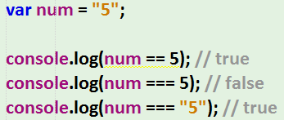
Comparison and Logical Operators
Operator | Description
== | equal to
=== | equal value and equal type
!= | not equal
!== | not equal value or not equal type
> | greater than
< | less than
>= | greater than or equal to
<= | less than or equal to

Slide 10

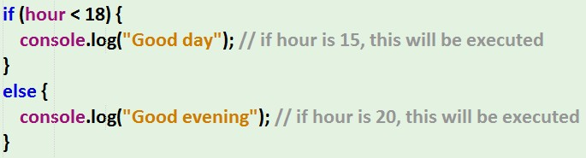
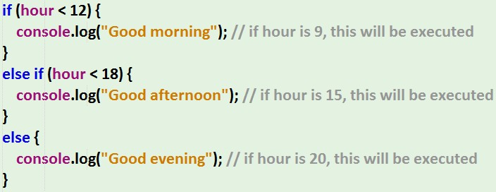
Conditions

Slide 11
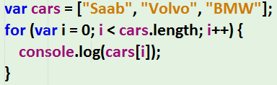
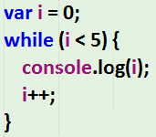
Loops

Slide 12
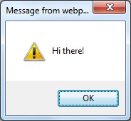
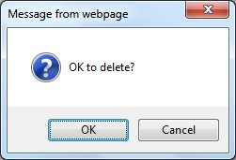
Popup boxes
Alert box
alert(“Hi there!")
Confirm box
confirm(“OK to delete?")

Slide 13
Javascript Functions
A JavaScript function contains some code that will be executed only by an event (user clicks a button) or by a call to that function
To keep the browser from executing a script as soon as thepage is loaded, you can write your script as a function
You may call a function from anywhere within the page (or even from other pages if the function is embedded in an external .js file).
Functions can be defined either <head> or <body> section
As a convention, they are typically defined in the <head> section

Slide 14


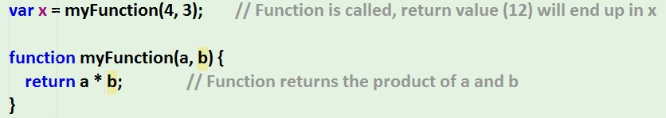
Function syntax
Function names can contain letters, digits, underscores, and dollar signs (same rules as variables).
When JavaScript reaches a return statement, the function
will stop executing.

Slide 15
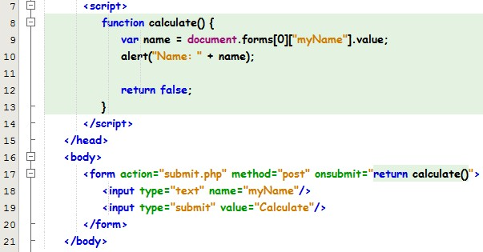
Function invoked by event

Slide 16
String functions
var myString = “An apple“;
Function | Usage
charAt(x) | e.g. myString.charAt(5) // returns “p”
indexOf(substr) | e.g. myString.indexOf(“apple") // returns 3
replace(substr, replacetext) | e.g. myString.replace(“apple”, “orange") // returns “An orange”
substring(from, [to]) | e.g. myString.substring(0, myString.indexOf(“ “)) // returns “An”
split(delimiter, [limit]) | e.g. var word = myString.split(“ “); word[0] // contains “An” word[1] // contains “apple”
toLowerCase(), toUpperCase() | e.g. myString.toLowerCase() // returns “an apple” e.g. myString.toUpperCase() // returns “AN APPLE”
length | e.g. myString.length // returns 8
And many more…. | http://www.w3schools.com/jsref/jsref_obj_string.asp

Slide 17
Other useful functions
Function | Description
parseInt() | Converts a string to integer e.g. var num = “5”; num.parseInt() // returns 5
set/getDate() | Set/Get the day to/as a number (1-31)
set/getFullYear() | Set/Get the four digit year (yyyy)
set/getMonth() | Set/Get the month (0-11)
And many more…. | http://www.w3schools.com/jsref/jsref_obj_date.asp
var currentTime = new Date();
var month = currentTime.getMonth() + 1;
var day = currentTime.getDate();
var year = currentTime.getFullYear(); console.log(month + "/" + day + "/" + year);

Slide 18

Anonymous Functions
An anonymous function is a function that was declared without any named identifier to refer to it. As such, an anonymous function is usually not accessible after its initial creation.
https://en.wikibooks.org/wiki/JavaScript/Anonymous_functions

